Slide 1
Final report
Ifreador Aziagbe
Course number: DATA 205
CRN: 34669
Professor: Lori A. Perine
Project title: Analyzing the Impact of Socioeconomic Factors on Traffic Crash Frequency and Severity in Montgomery County.

Slide 2
Introduction
Income Dataset – Provides median household income estimates for 46 ZIP codes, sourced from: https://data.census.gov, https://www.incomebyzipcode.com/maryland/, and https://worldpopulationreview.com/zips/maryland
Crash Reporting Dataset – Contains detailed records of traffic collisions collected by the Maryland State Police through the Automated Crash Reporting System (ACRS), with reports from county and municipal police. Source: Montgomery County Data | Open Data Portal.
Crime Dataset – Includes reported crime data classified under the National Incident-Based Reporting System (NIBRS) and compiled using the EJustice system, widely used by local law enforcement.: Montgomery County Data | Open Data Portal.

Slide 3
Goals and why they are important
Goals
Why are they important?
Goal 1: To analyze, understand, and potentially predict the key factors that contribute to the severity and frequency of traffic crashes in Montgomery County
Goal 2: Examine how traffic crash rates in Montgomery County vary by household income levels across ZIP codes, as well as crime report incidents
These goals are important because they use data to make Montgomery County safer and fairer for everyone. Instead of just dealing with crashes after they happen, these goals try to figure out why they happen in the first place, so we can stop them from happening.

Slide 4
Tools and data cleaning
Python Libraries:
Pandas,
NumPy for data wrangling;
Seaborn,
Matplotlib, Plotly for visualization;
Geospatial Analysis: Folium for mapping crash hotspots;
Statistical Tests: Chi-square for categorical relationships;
correlation analysis for numerical relationships, and Documentation: Jupyter Notebooks, with version tracking and code comments.
I merged datasets using the ZIP code and locations
I standardized column names and formats.
Converted dates and extracted the year and month.

Slide 5
Visualizations

Slide 6
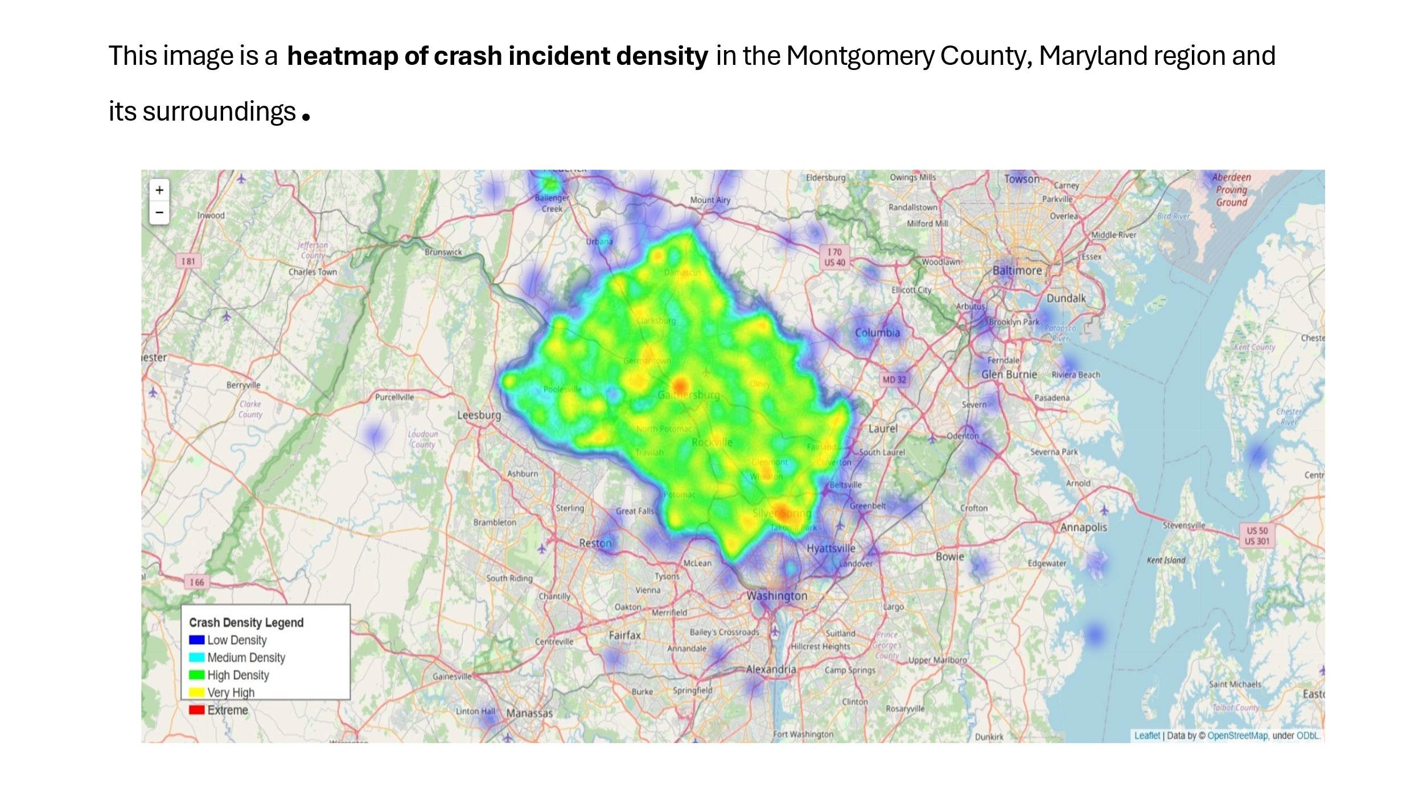

Slide 7
Interpretation
Gaithersburg, Rockville, and Germantown are the areas with the highest crash density, shown in red and yellow.
Silver Spring also shows a very high crash concentration.
Areas like Poolesville, North Potomac, and Olney show moderate crash density (green).
Peripheral zones like Leesburg, Annapolis, and Bowie exhibit low crash activity (blue or barely visible).
Density Level Number of Locations (Crash Density)
Low (Blue) 22047
Medium (Cyan) 188
High (Green) 27
Very High (Yellow) 2
Extreme (Red) 1

Slide 8
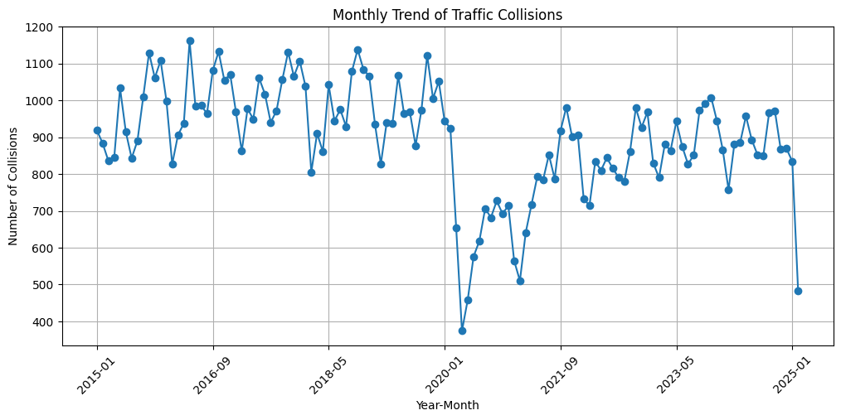
This line chart shows the monthly trend of traffic collisions from 2015 to early 2025
From 2015 to early 2020, collisions stayed high
In 2020, there was a sharp drop, likely due to COVID-19
After 2021, collision counts gradually rose again but stayed more variable.
drop at the end (2025) might reflect incomplete or lagging data.

Slide 9
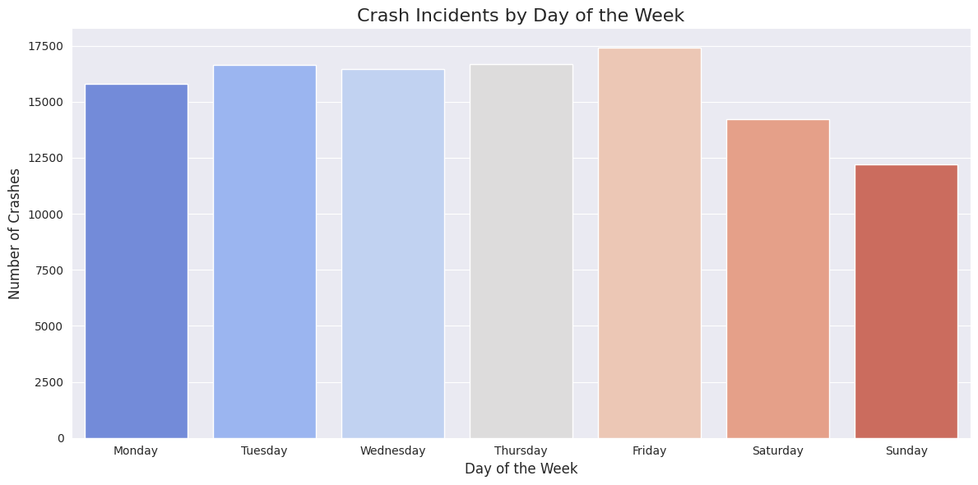
This bar chart shows the number of crash incidents by day of the week.
Friday has the highest number of crashes (nearly 17,500),
Monday–Thursday have similar, slightly lower levels,
Saturday drops noticeably, and Sunday has the lowest crash count.

Slide 10
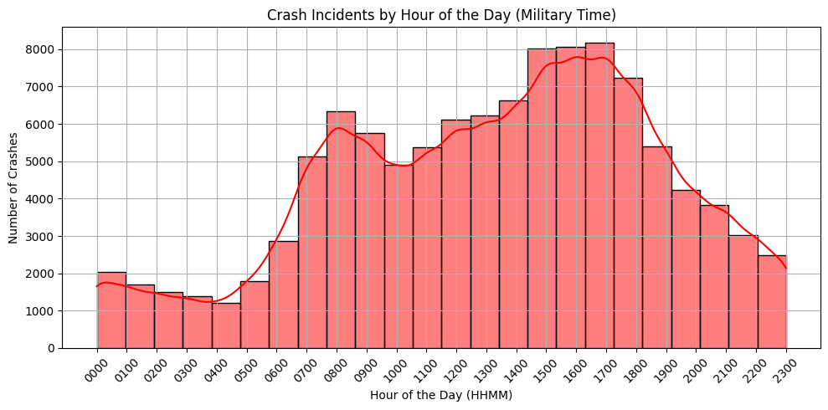
Crash incidents by hour of the day
Crashes peak around 3-6 pm
Small spike occurs around 8-9 pm
Fewest crashes happen between 2-5 AM

Slide 11
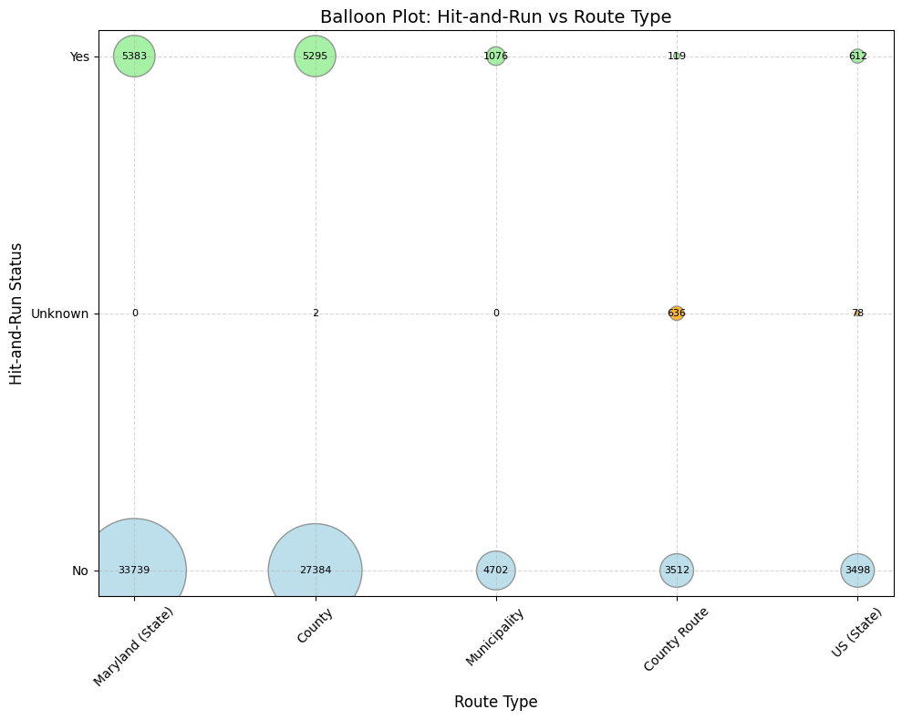
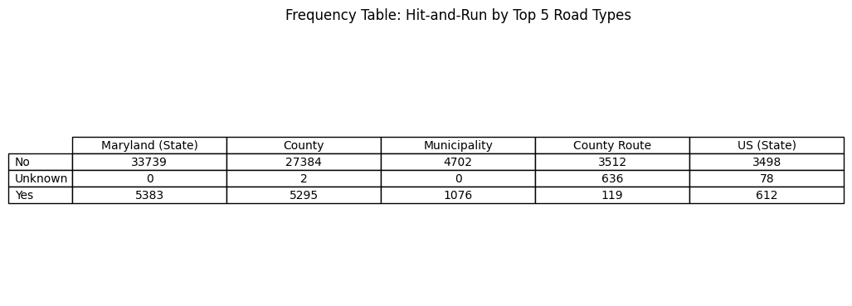
Is road type significantly associated with hit-and-run occurrence in crash incidents? (Chi-Square)
P-value = 0

Slide 12
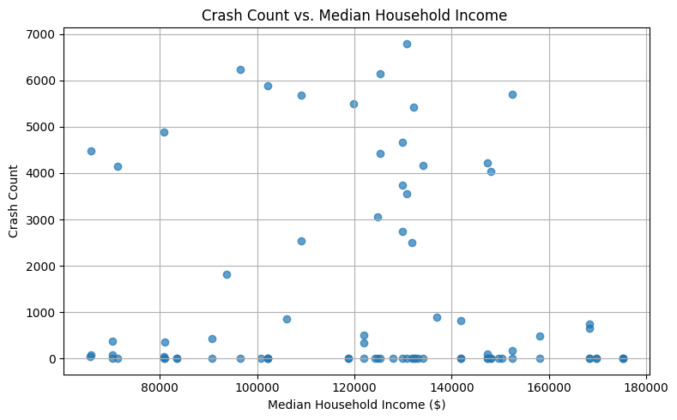
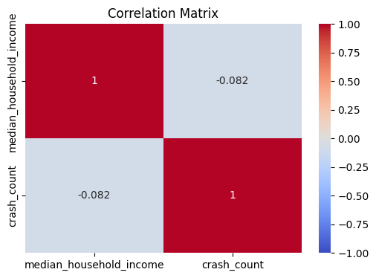
The scatter plot and correlation matrix heatmap show the relationship between Crash Count and Median Household Income in different areas of Montgomery County.
The chart shows a weak negative relationship between median household income and crash count in Montgomery County:
Correlation matrix = - 0.082

Slide 13
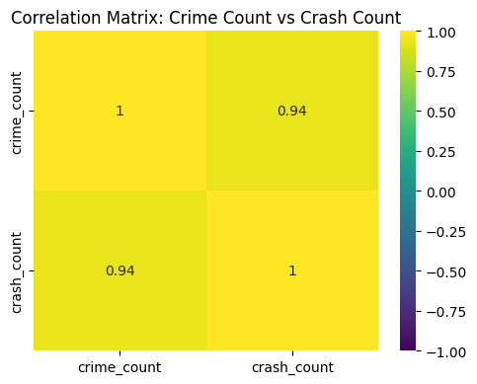
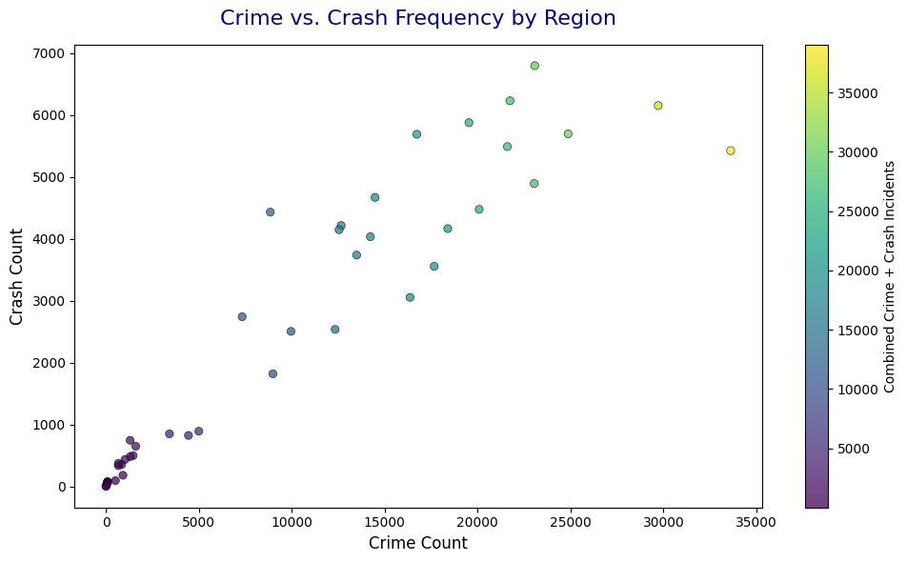
Relationship Between Crime And Crash Counts By Region
Correlation matrix = 0.94
Each dot = a pseudo–region (created by rounding latitude)

Slide 14
Overall project conclusion
Overall, crash incidents in Montgomery County are strongly linked to high-crime areas, especially in urban centers. Income has little effect on crash rates. Most crashes happen during rush hours and on weekdays, with hit-and-run cases more common on state and county roads. These findings highlight the need for targeted safety efforts in high-risk zones and times.

Slide 15
Recommendations
Focus on crash hotspots (Gaithersburg, Rockville, Silver Spring). Increase Friday traffic safety measures. Combine crime and crash interventions in high-risk areas. Adjust strategies for post-pandemic traffic patterns. Tailor some safety efforts to lower-income areas. Promote safe driving every day of the week.

Slide 16
Aknowledgement
I sincerely thank my professors for their guidance and support throughout this project
•Professor Alraee • Professor Perine • Professor Mohamed

Slide 17
References
https://data.census.gov, https://www.incomebyzipcode.com/maryland/, and https://worldpopulationreview.com/zips/maryland
Montgomery County Data | Open Data Portal.

Slide 18

Thank you
!

